Slide 1




Image Captioning

Slide 2
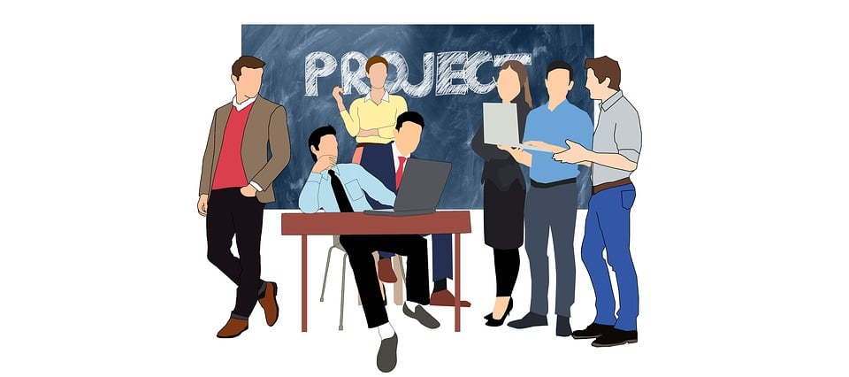
Team Members
Deep Sureja(20BECE30255)
Dhruvin Vachhani (20BECE30271)
Jash Umretiya (20BECE30270)
Hitarth Upadhyay (20BECE30286)
Guided By :Dr. Lokesh Gagnani

Slide 3
CONTENT
Introduction To Image Captioning
Real life Use cases of Image Captioning
Technology Aspect
Applications
Requirements
Implementation
Technology Used

Slide 4
Introduction To Image Captioning
Image Captioning is the process of generating a textual description for given images.
It has been a very important and fundamental task in the Deep Learning domain. Image captioning has a huge amount of application.
NVIDIA is using image captioning technologies to create an application to help people who have low or no eyesight.

Slide 5
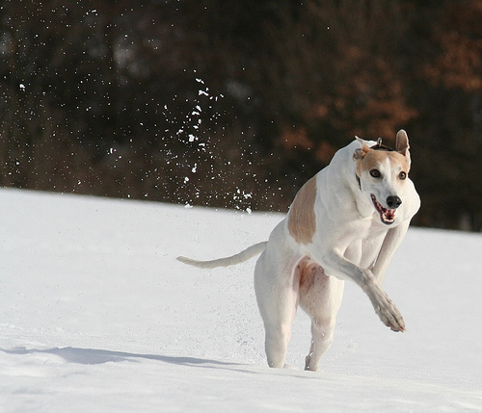
What do you see in this Picture ?

Slide 6
Well some of you might say "A white dog on a snow", some may say "A white dog with brown spots" and yet some others might say "A dog is running on the snow"
Definitely all of these captions are relevant for this image and there may be some others also but the point I want to make is; it's so easy for us as human beings, to just have a glance at the picture and describe it in an appropriate language.
But can you write a computer program that takes an image as input and product a relevant caption as output? The answer is Yes. We can write a computer program which is a combination of Neural network, CNN and LSTM

Slide 7
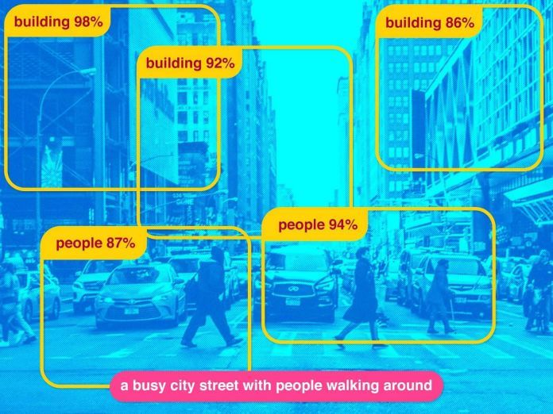
Real life Use cases of Image Captioning
Word Detection Stage & Multiple Instance Learning.
Sentence Genration Stage.
Ranking Generated Sentence.

Slide 8
Technology Aspect
A captioning model relies on two main components, a CNN and an RNN. captioning is all about merging the two, to combine their most powerful attributes.
CNN(Convolution neural networks) Excel at preserving spatial information and recognise objects in images.
RNNs (Recurrent neural networks) work well with any kind of sequential data, such as generating a sequence of words.

Slide 9
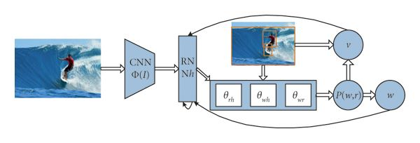
so by merging the two, you can get a model that can find patterns and images, and then use that information to help generate a description of those images.
For that user have to take picture and click on prediction button and get image captioning volume.

Slide 10
Applications
Aid to the blind :-- we can create a product for the blind which will guide them travelling on the roads without the support of anyone else . we can do this by first converting the scene into text and then the text to Voice. both are now famous applications of deep learning.
Self driving cars :-- Automatic driving is one of the biggest challenges and if we can properly caption the scene around the car, it can give a boost to the self driving system.

Slide 11
Requirements
Hardware Requirements
Processor : Any Processor above 500 MHz.
Ram : 4 GB
Hard Disk : 4 GB
Input Device: Standard Keyboard and Mouse.
Software Requirements
Operating System: Windows 7 or higher
Programming : Python 3.7 and related libraries

Slide 12
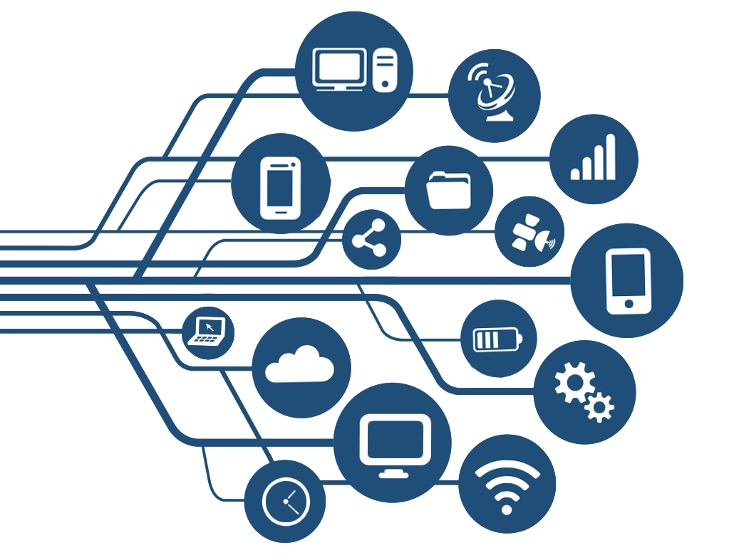
Technology Used
Python 3.7
Pandas
Numpy
Tensorflow
Keras
Resnet50
CNN
RNN
LSTM

Slide 13
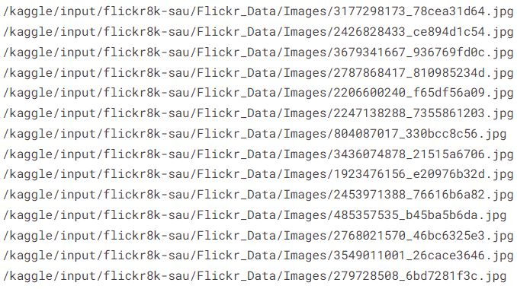
Data Collection
There are many open source data sets available for this problem like flickr8k (containing 8k images), flickr30k (containing 30k images), MS COCO (containing 180k images), etc.
Here We Used flickr8K Dataset

Slide 14
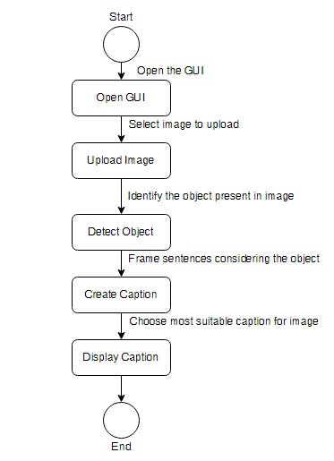
State Diagram

Slide 15
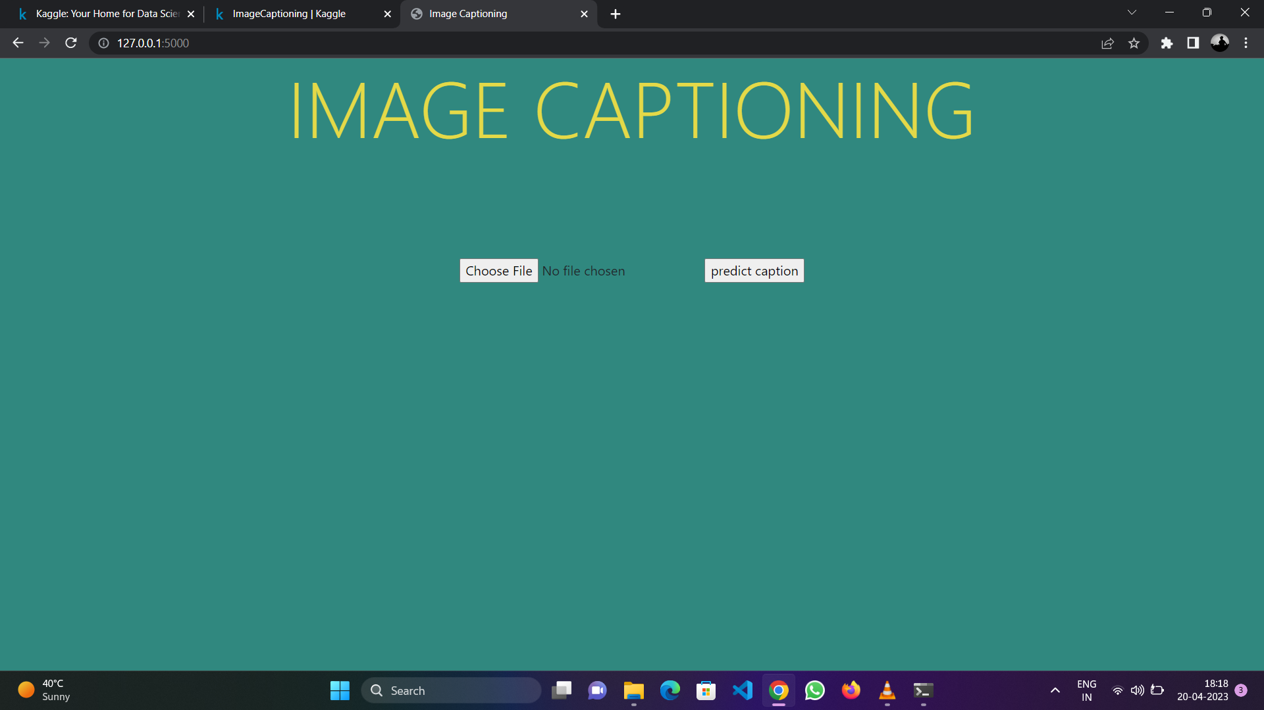
Implementation

Slide 16
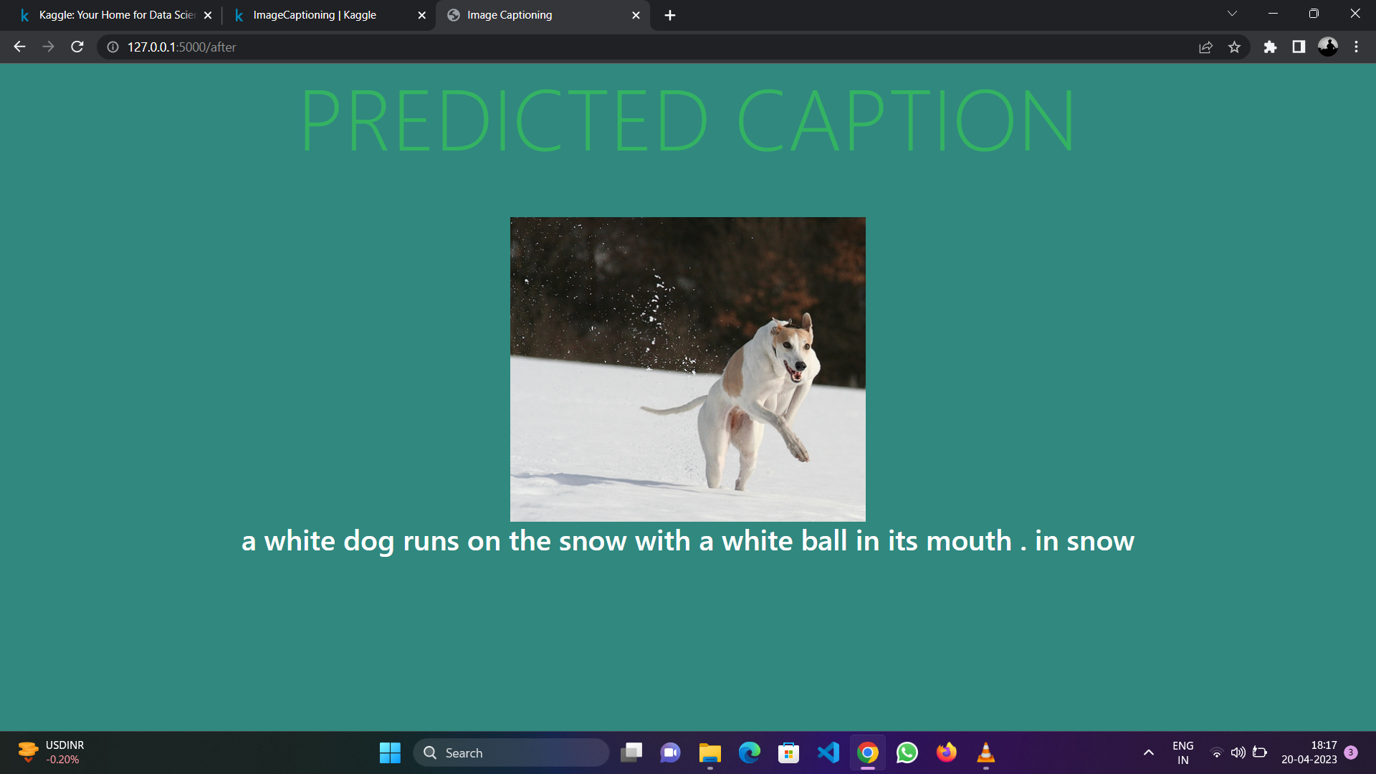

Slide 17


